Slide 1
Intelligent Classification of Rural Infrastructure Projects
CAPSTONE PROJECT
Presented By:
Student Name- Aditya Raj
College Name- Birla Institute of Technology, Mesra
Department- Electronics & Communication Engineering

Slide 2
OUTLINE
Problem Statement
Proposed System/Solution
System Development Approach
Algorithm & Deployment
Result (Output Image)
Conclusion
Future Scope
References

Slide 3
Problem Statement
The Pradhan Mantri Gram Sadak Yojana (PMGSY) is a critical rural infrastructure program in India. It has evolved through various phases like PMGSY-I, PMGSY-II, and RCPLWEA, each with unique goals and specifications.
Government bodies and planners face a significant challenge in categorizing thousands of road and bridge projects under their correct scheme. The current manual classification process is:
Time-consuming and labor-intensive.
Prone to human error, leading to inconsistent data.
Difficult to scale as the number of projects grows.
This inefficiency hinders effective monitoring, transparent budget allocation, and accurate assessment of each scheme's impact.

Slide 4
Proposed Solution
I propose building and deploying a machine learning model on the IBM Cloud platform using Auto AI to automatically classify a project into its correct PMGSY_SCHEME.
The solution, built entirely within the IBM ecosystem, involves:
Data Collection & Storage: Ingesting and storing the PMGSY project dataset securely in IBM Cloud Object Storage.
Data Preprocessing: Using IBM Watson Studio Data Refinery to visually clean, shape, and prepare the data for model training.
Machine Learning Model: Leveraging Watsonx.ai Studio to build, train, and tune a supervised classification model.
Deployment: Deploying the trained model as a scalable web service using IBM Watson Machine Learning for easy integration into other applications.
Evaluation: Rigorously testing the model's performance using the evaluation tools within Watsonx.ai.

Slide 5
System Approach
My approach leverages the integrated, end-to-end services of the IBM Cloud platform.
Platform Requirements:
An active IBM Cloud account.
Provisioned instances of Watsonx.ai and IBM Watson Machine Learning.
IBM Services Used:
IBM Cloud Object Storage: For secure and scalable data storage.
IBM Watson Studio: The integrated environment for all data science tasks.
Data Refinery: For no-code data preparation and cleansing.
Jupyter Notebooks: For any custom data exploration and visualization code.
Watsonx.ai: For building the classification model using either the AutoAI experiment for automated model selection or by building a custom model.
Web UI Implementation:
Streamlit: To build an interactive web application that consumes the deployed model's public endpoint and API key, enabling real-time predictions.

Slide 6
Algorithm & Deployment
Algorithm Selection & Training:
I will use the AutoAI feature within Watsonx.ai. AutoAI will automatically prepare
the data, apply various classification algorithms (like Random Forest, XGBoost, etc.),
and engineer features to find the best-performing model pipeline for our PMGSY dataset.
This automates the model selection process, ensuring I use the most accurate algorithm
for our specific data.
Data Input:
The model will be trained on features from the dataset stored in Cloud Object Storage.
Deployment:
Once the best model pipeline is identified by AutoAI, it is saved to the IBM Watson Machine
Learning repository.
From there, the model is deployed with a single click as a REST API endpoint. This makes
the model's predictive power available as a secure, scalable web service that can be called
by any authorized application.

Slide 7
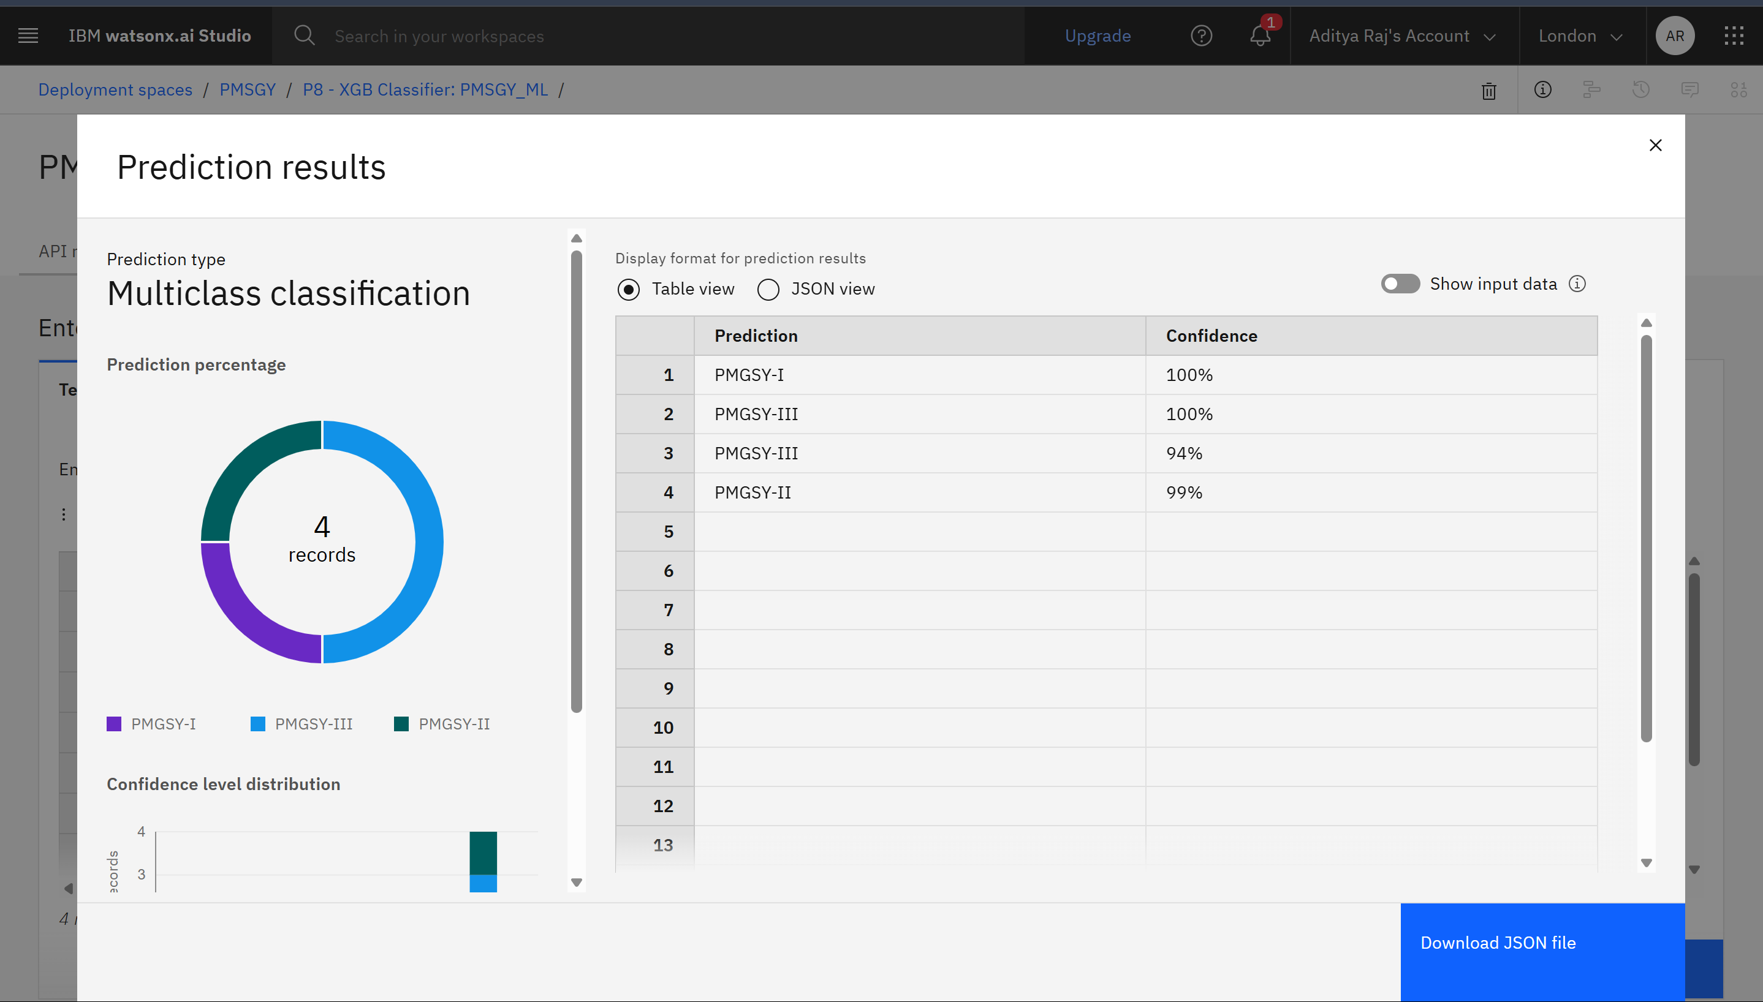
Result
Here is a summary:
Overall Performance:
The model demonstrated very high confidence in its predictions for all four records. All predictions were made with a confidence level of 94% or higher.
Prediction Breakdown:
Record 1: Correctly predicted as PMGSY-I with 100% confidence.
Record 2: Correctly predicted as PMGSY-III with 100% confidence.
Record 3: Correctly predicted as PMGSY-III with 94% confidence.
Record 4: Correctly predicted as PMGSY-II with 99% confidence.
Class Distribution: The results show that your model successfully identified records belonging to all three different classes. Out of the four test records, two were classified as PMGSY-III, one as PMGSY-I, and one as PMGSY-II.

Slide 8
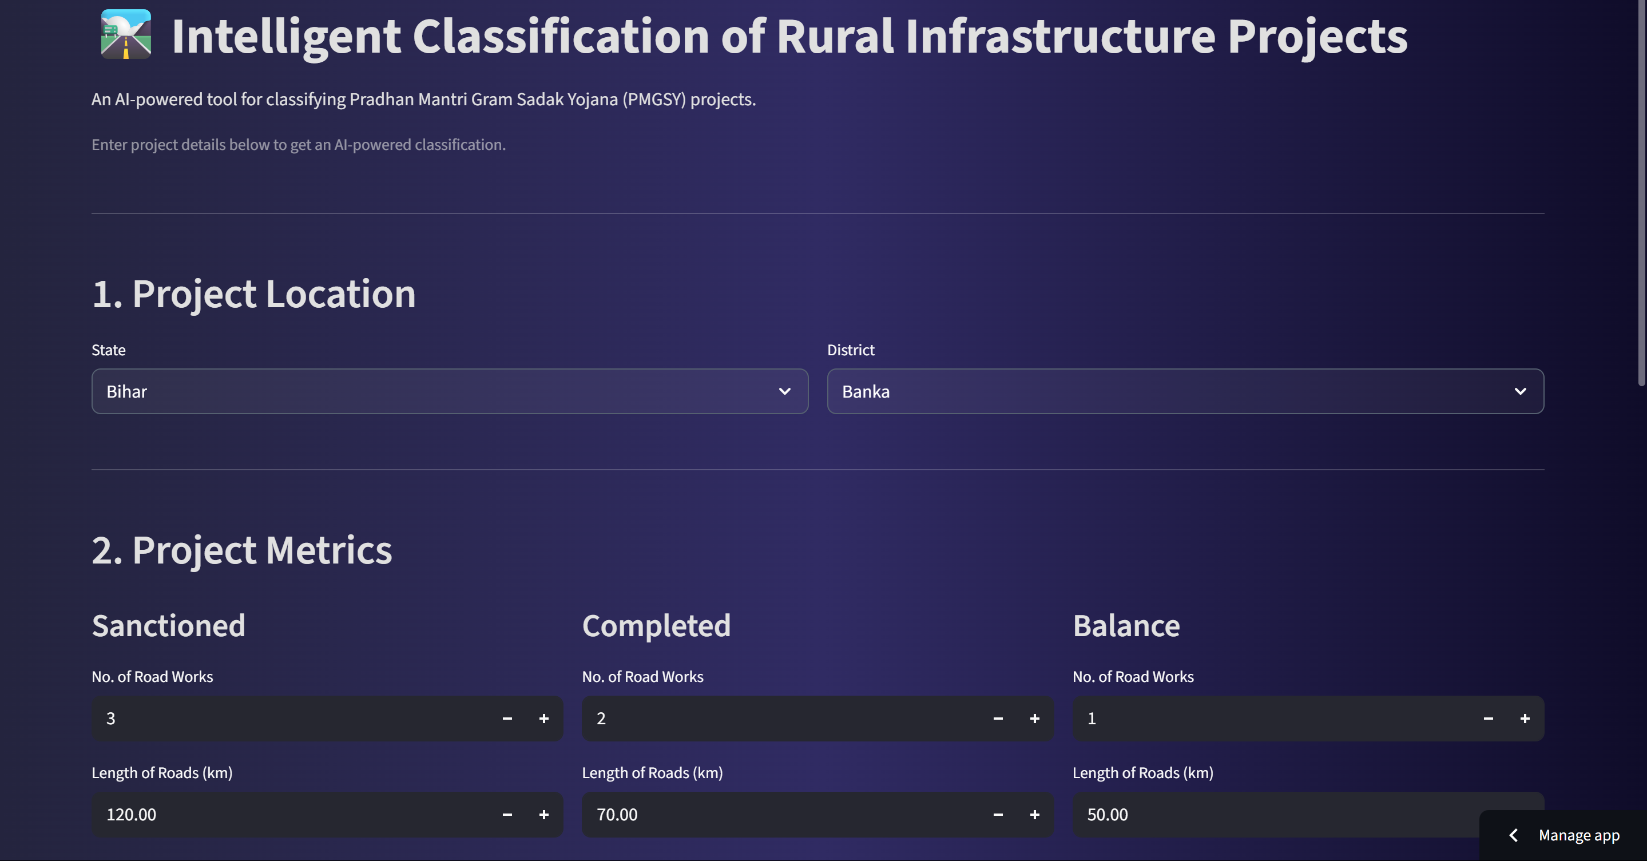
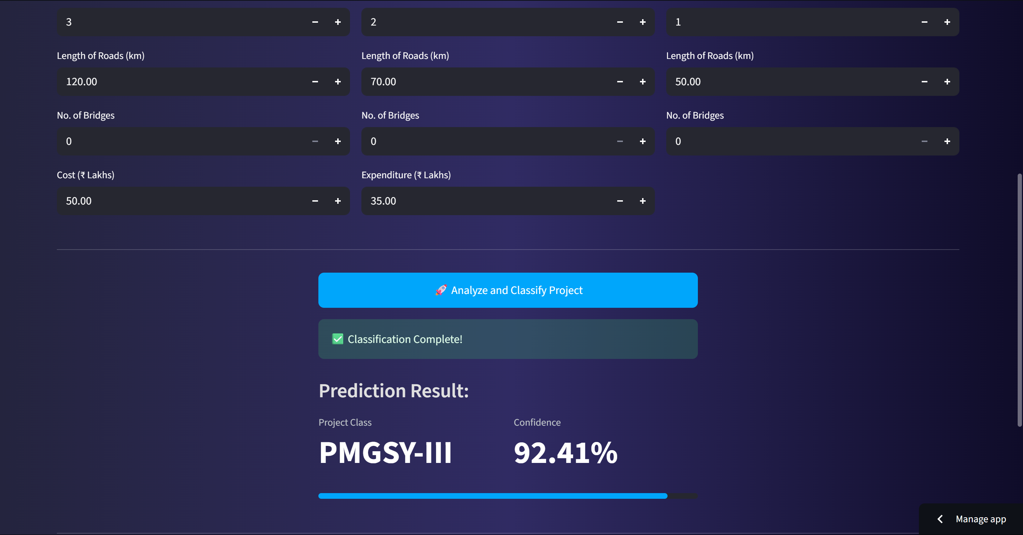
Result
To demonstrate the model's real-world application, we developed a user-friendly web UI using Streamlit. This interactive dashboard allows users to input project metrics and calls the deployed AI model via an API and Public end-point url.. It then instantly displays the predicted PMGSY project class and the model's confidence score, providing a seamless and practical tool for real-time classification.

Slide 9
Result
GitHub Repository Link:
https://github.com/Aditya-R01/PMSGY-Classification-Project-using-IBM-Cloud-Services
WebApp Link:
https://pmsgyclassification.streamlit.app/

Slide 10
Conclusion
I successfully developed and deployed a highly accurate classification model using an end-to-end workflow on IBM Cloud and Watsonx.ai.
The use of Watsonx.ai AutoAI significantly accelerated the model development process while ensuring high performance.
Deploying the model with IBM Watson Machine Learning provides a robust, scalable, and secure solution that is ready for enterprise use.
This tool can empower government bodies to conduct more effective monitoring, ensure transparent financial management, and perform robust policy analysis.

Slide 11
Future scope
Integrate with a Chatbot: Use IBM watsonx Assistant to create a chatbot where officials can ask for a project's classification in natural language.
Expand Predictive Capabilities: Utilize other tools in Watsonx.ai to predict project completion times or potential cost overruns, creating a comprehensive project analytics solution.

Slide 12
References
Pradhan Mantri Gram Sadak Yojana (PMGSY) Official Website and Guidelines.
IBM Cloud Documentation: https://cloud.ibm.com/docs
IBM Watsonx.ai Documentation.
IBM Watson Machine Learning Documentation.

Slide 13
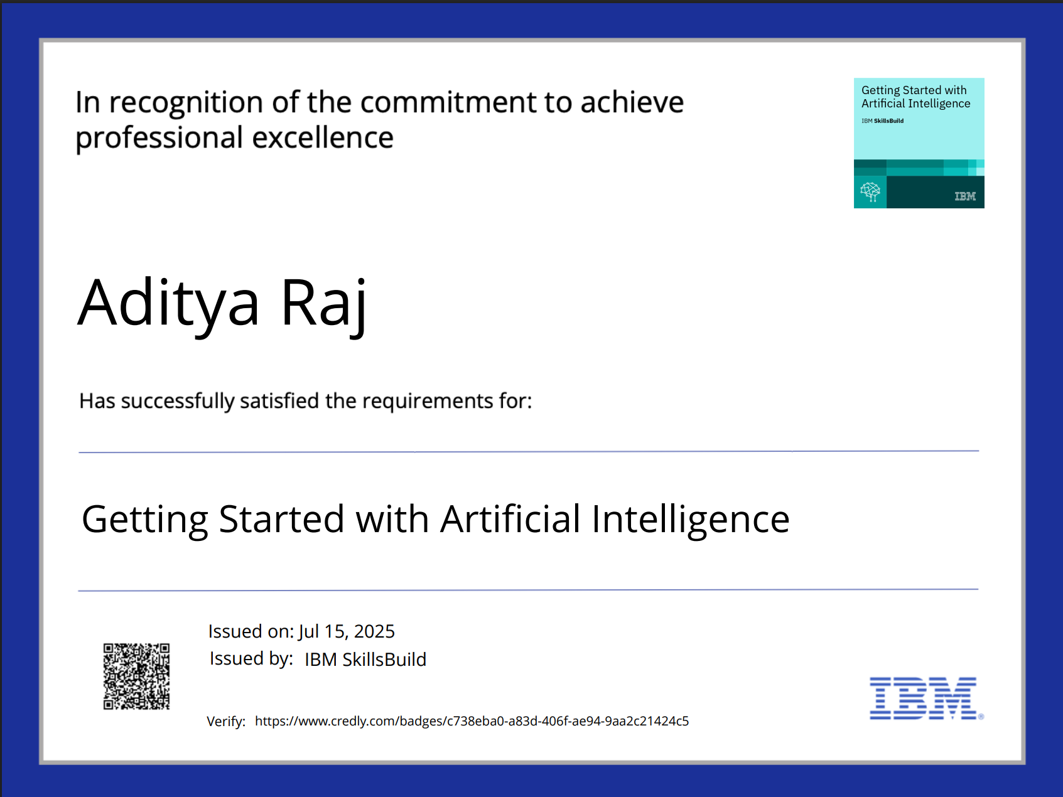
IBM Certifications

Slide 14
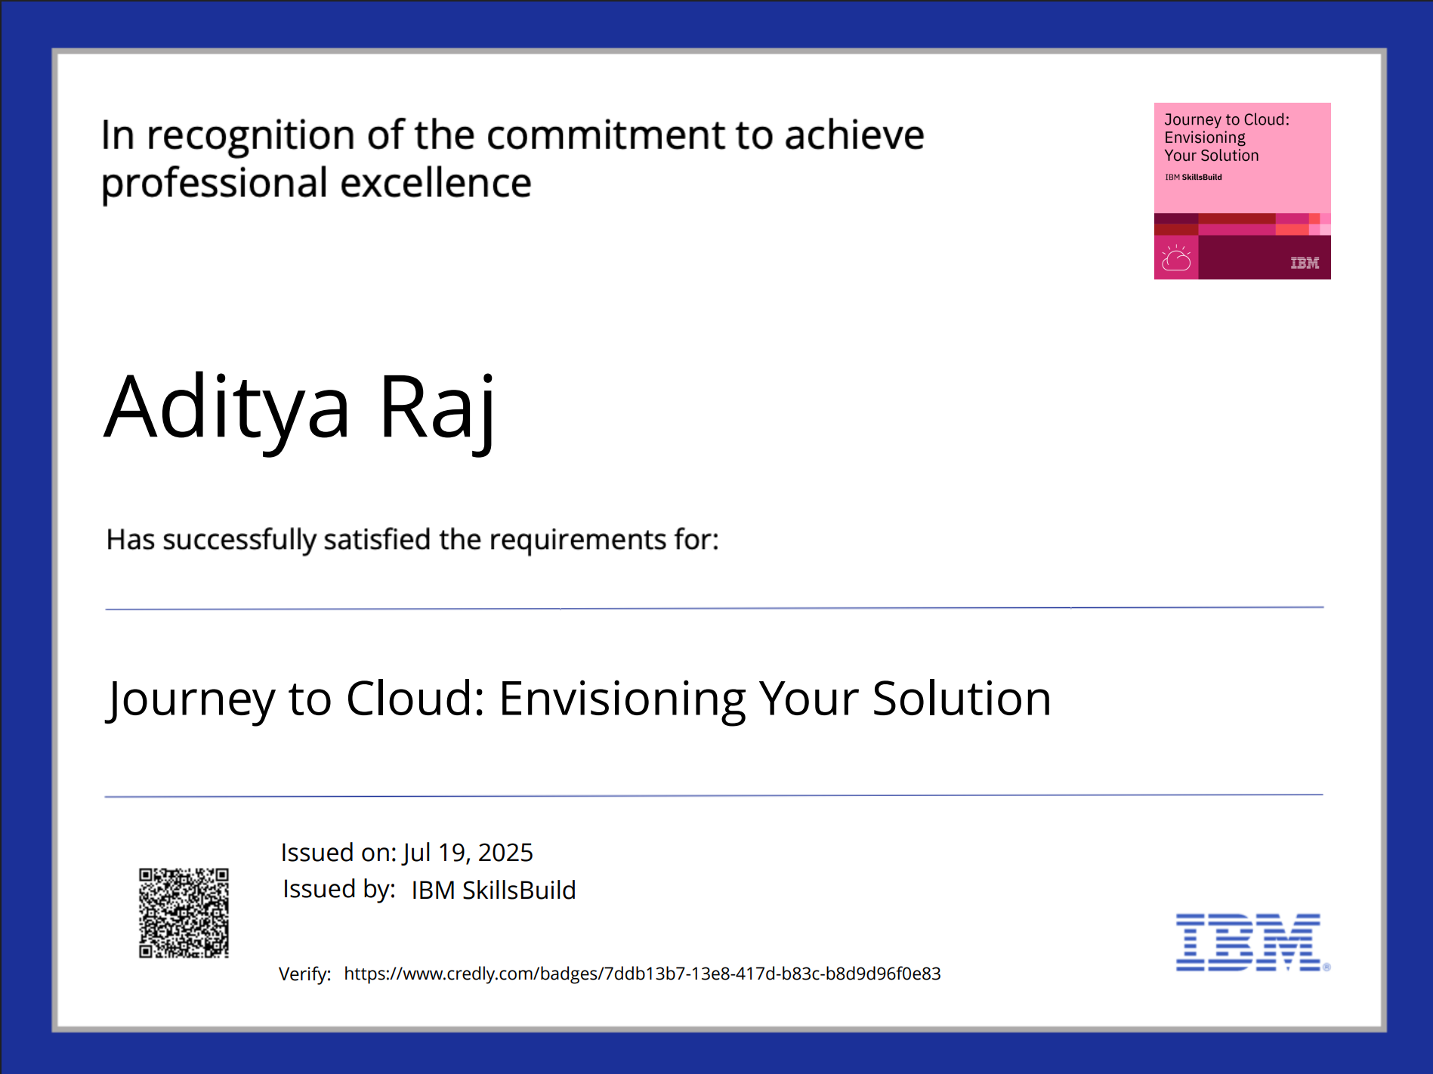
IBM Certifications

Slide 15
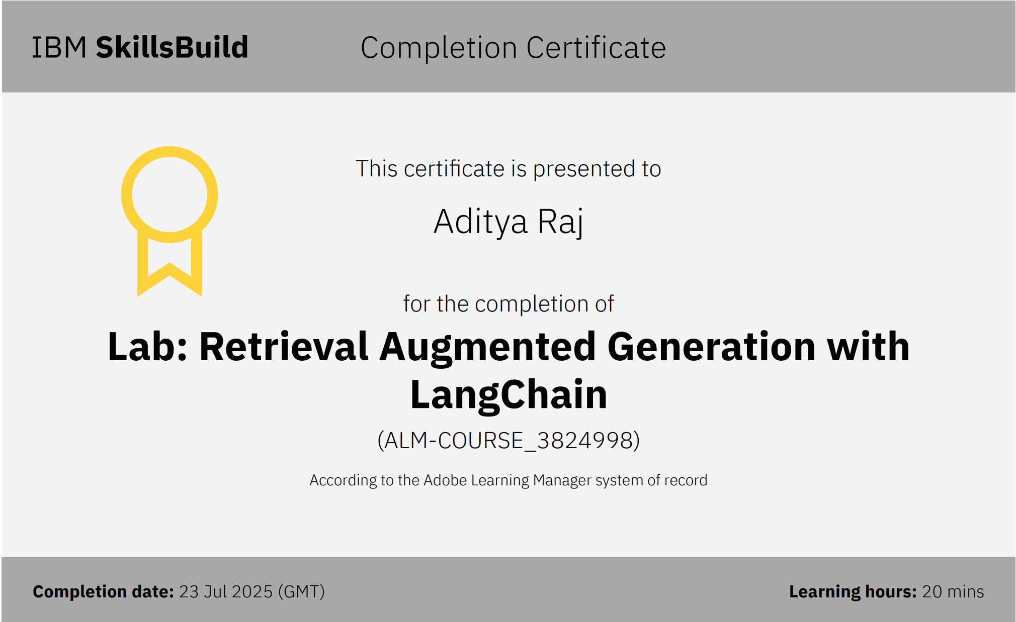
IBM Certifications

Slide 16
THANK YOU

